Slide 1

Advancing Racial Equity and inclusion In Program Design
2021 National Community Development Conference
Carmen Gandulla
Acting Finance Director
Community Development Director
City of Jersey City, NJ

Slide 2
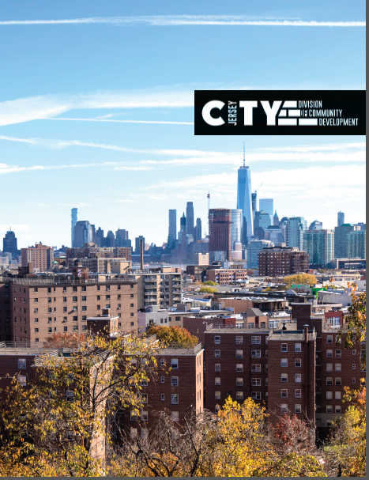
Jersey City- NJ
Jersey City was established in January of 1820
Jersey City has a population of approximately 270,753 people as of 2017 and has the largest and most dense population in Hudson County.
The population has been steadily increasing since 2010.
The City measures 14.79 miles square.
#JCMakeitYours
https://www.youtube.com/watch?v=Uazk21-BImU

Slide 3
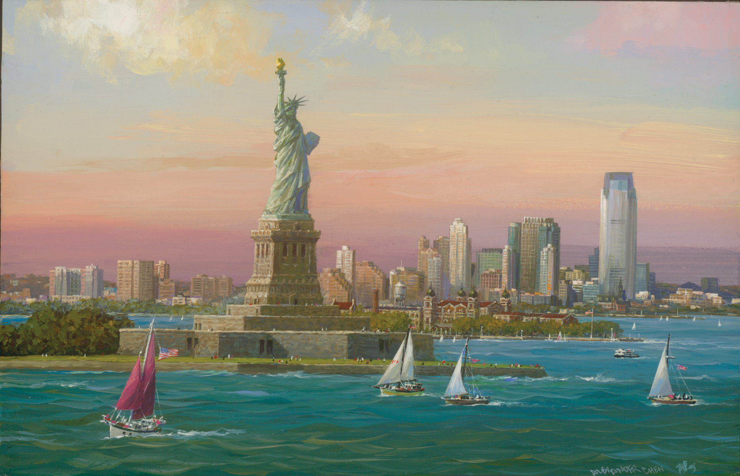
FUN FACT
Jersey City- NJ
The Statue of Liberty’s Address is
1 Communipaw Avenue, Jersey City.
Ellis Island’s Address is
2 Communipaw Avenue,
Jersey City
#ladyliberty
#sheisours

Slide 4
What is Racial Equity and Inclusion?
How do you define it?

Slide 5
Equity Considerations
Diversity asks:
Who is in the room?
Equity responds:
Who is trying to get in the room but can’t?
Inclusion asks:
Has Everyone’s ideas been
heard?

Slide 6
Equity Considerations
Justice Responds:
Whose ideas won’t be taken as seriously because they are not the majority?
Diversity Asks:
How many more of (pick any minoritzed identified) group do we have this year than last
Equity responds:
What conditions have we created that maintain certain groups as the perpetal majority here?
Source: Dr. D-L Stewart, Colorado State University

Slide 7
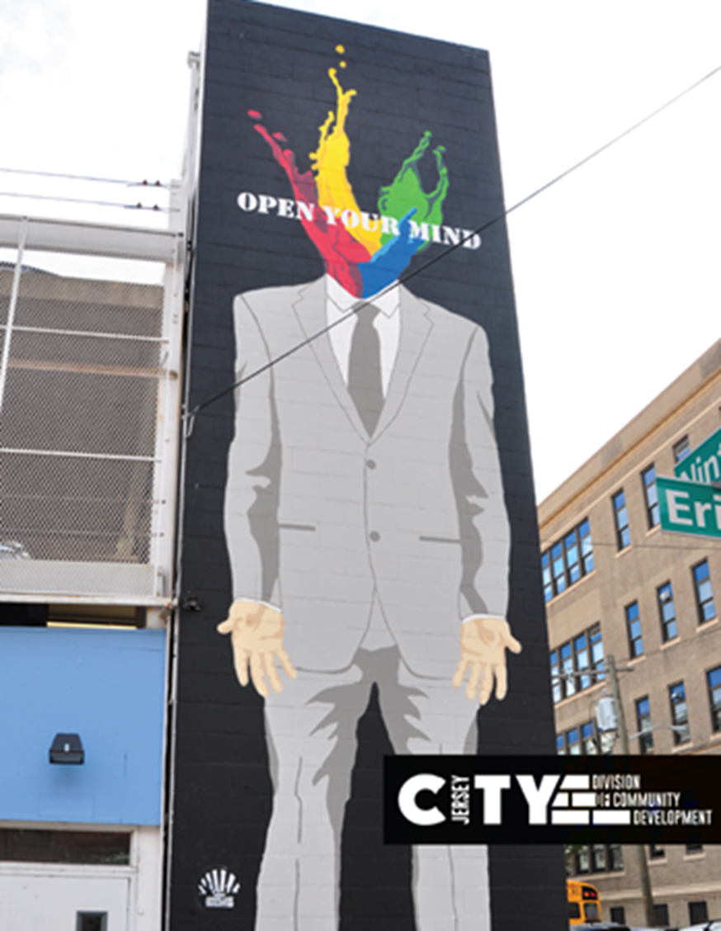

Slide 8
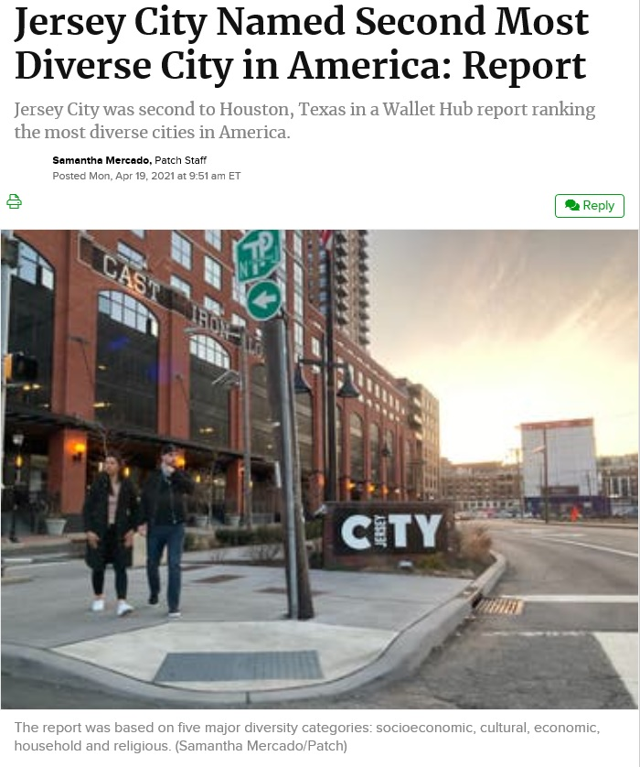

Slide 9
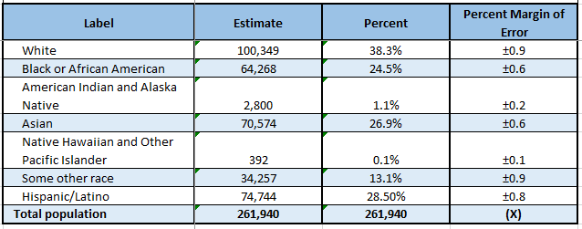
Jersey City Census Data

Slide 10
What Can be done?
Local Level Action

Slide 11

Community Development Allocation
Review all grants and frame the administrative policies from the strategic plan (C-Plan) into your yearly action plan.
What does your Language Access Plan demonstrate? Or Analysis of Impediments?
What does your funding plan look like?
Self Assessment?
Who can you partner with or reach out?

Slide 12
Capacity Building Program Design
Budget & Administrative Policy Review
Present your Ideas & Have Conversations
Make it actionable with 5 the year c-plan.

Slide 13


Capacity Building Program Design
Budget Review

Slide 14
Capacity Building Program Design
Grant Type | FY 2021 HUD Entitlement Allocations
CDBG | $5,904,319.00
HOPWA | $2,381,307.00
ESG | $498,420.00
HOME | $2,125,407.00
Total | $10,909,453.00

Slide 15
Capacity Building Program Design
Budget Review of Public Services

Slide 16
CDBG Public Services | FY 2020 | FY 2021
Big Brothers Big Sisters | $57,000.00 | $54,675.00
Educational Arts Team (Violence Prevention) | $20,000.00 | $19,184.00
Girl Scouts Heart of NJ | $10,000.00 | $9,592.00
Hudson County Court Appointed Special Advocates (CASA) | $50,000.00 | $47,961.00
JC Connections/Hudson Pride Connections Center | $25,000.00 | $23,980.00
New City Kids, Inc. (After School) | $15,000.00 | $14,389.00
Nimbus Dance Works | $13,000.00 | $12,470.00
Team Walker | $10,000.00 | $9,592.00
Team Wilderness | $8,500.00 | $8,153.00
The Kennedy Dancers, Inc (Inner City) | $10,000.00 | $9,592.00
Urban League of Hudson County (GSS) | $11,500.00 | $11,032.00
Summer Youth Programs | $140,000.00 | $95,923.00
Act Now Foundation, Inc. | $15,000.00 | $14,388.00
Grace Van Vorst Community Svc | $20,000.00 | $19,184.00
The Kennedy Dancers, Inc. (Seniors) | $10,000.00 | $9.592.00
Collaborative Support Programs of NJ | $36,800.00 | $35,300.00
Garden State Episcopal CDC (Homeless Outreach) | $100,000.00 | $95,921.00
Palisades Emergency Residence Corp | $75,000.00 | $71,941.00
York Street Project (St. Joseph's Bridge Housing) | $60,000.00 | $57,553.00
Philippine American Friendship | $7,500.00 | $7,195.00
NJ Citizen Action Education Fund | $7,500.00 | $7,195.00
The Waterfront Project, Inc. (Housing Counseling) | $50,000.00 | $47,960.00
Urban League of Hudson County (Power up) | $11,500.00 | $11,032.00
Women Rising, Inc. (Domestic Violence Services) | $40,000.00 | $38,368.00
Women Rising, Inc. (Workforce Development) | $60,000.00 | $57,553.00
The City of Jersey City’s Division of Community Development funds 25 programs across 23 non-profit agencies, as well as several Summer Youth Programs like Little League Baseball.

Slide 17
Organization | Grants | Amount
Big Brothers Big Sisters of Essex, Hudson and Union | Victoria Foundation | $75,000.00
 | BNY Mellon | $40.000.00
 | William E. Simon Foundation | $125,000.00
 | Leslie Quick III | $567,702.00
Educational Arts Team | Turrell Fund | $7,000.00
 | The Henry & Marilyn Taub Foundation | $20,000.00
 | Dodge Foundation | $33.000.00
Jersey City Connections/Hudson Pride | RAVAL, LLC | $1,022.00
 | Carepoint Health Foundation | $6,000.00
 | Imperial Court of NY, Inc. | $5,665.00
Palisades Emergency Residence Group | Wells Fargo - Ohio Foundation | $20,000.00
 | UPS Foundation, Inc. | $20,000.00
 | Oritani Bank Charitable Foundation | $20,000.00
Rising Tide Capital | The Grace & Mercy Foundation, Inc. | $375,000.00
 | The Nicholson Foundation | $729,110.00
 | The Diana Davis Spencer Foundation | $5,025,000.00
 | JP Morgan Chase Foundation | $632,000.00
 | The Prudential Foundation | $603,000.00
 | Novo Foundation | $2,250,000.00
Nimbus Dance Works | Dodge Foundation | $25,000.00
 | Grace Works Jersey City | $150,000.00
The Waterfront Project | Saint Peter and Paul Foundation | $53,284.00
 | Carepoint Health Foundation | $5,000.00
 | McMannon, Scotland & Bauman | $5,000.00
Team Walker | James & Judy O'Brien | $1,095,500.00
 | William E. Simon Foundation | $25,000.00
 | Gourmet Dining, LLC | $22,500.00
Several Foundations have generously provided additional funding to our CDBG and CSBG Sub-grantees.
Many of these Foundations recognize racial equity and inclusion as a part of their mission when funding agencies and non-profit organizations
The total amount invested by the Foundations that incorporated Racial Equity and Inclusion is $889,110.

Slide 18
Capacity Building Program Design
Administrative Policy Review

Slide 19
What Can be done?
Local Level Action

Slide 20
Jersey City Census Data

Slide 21
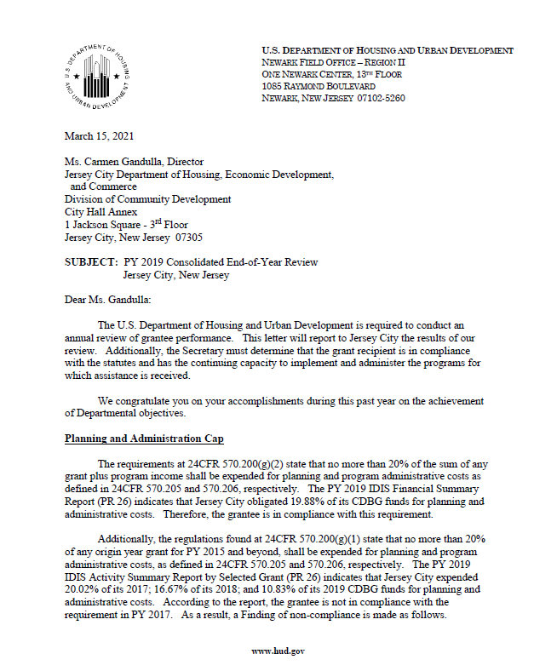
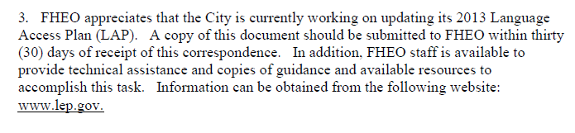
The annual Consolidated End-of-Year Review letter contains recommendations from the Office of Fair Housing and Equal Opportunity (FHEO) at HUD.
In the City’s 2019 Consolidated End-of-Year Review, the FHEO advises that they are awaiting our updated Language Access Plan (LEP).
An LEP is a document that spells out how to provide services to individuals who are non-English speaking or have limited English proficiency.

Slide 22


Capacity Building Program Design
Present your Ideas & Have Conversations

Slide 23
Capacity Building Program Design
The Geraldine R. Dodge Foundation and Rutgers Institute for Ethical Leadership launched of The Nonprofit Professionals of Color Collective leadership series.

Slide 24
Capacity Building Program Design
The Nonprofit Professionals of Color Collective is designed to provide a caucus space for New Jersey nonprofit professionals of color to engage in a supportive community for growth, professional development, and meaningful peer relationships.

Slide 25
Capacity Building Program Design
The course’s objectives include facilitated topics covered throughout the series include:
• Class and colorism;
• Safe spaces and intersectionality;
• Recognizing inner power;
• Shifting systems and navigating upward mobility;
• Recognizing and managing allies;
• Politics in the workplace;
• Speaking truth to power and consequences
• Fundraising

Slide 26


Capacity Building Program Design
Make it actionable with 5 the year C-Plan

Slide 27
Language | Ethnic Outreach | Publication Name | Media Type | Distributed to (Locations)
Arabic | Arab | Arab Voice Newspaper | Digital/Print | Jersey City, Patterson, NY
Chinese | Chinese | World Journal | Digital/Print | NJ/NY
English | Italian-American | Italian Tribune | Digital/Print | NJ, NY
English | Indian-American | Desi Talk | Digital/Print | Jersey City, NJ, NY, other
English | Filipino-American | Filipino Express | Digital/Print | Jersey City, NJ
English | Indian-American | India Abroad | Digital/Print | Jersey City, NY
English | All(English speaking) | The Bayonne Reporter | Digital/Print | Bayonne, NJ
English | All(English speaking) | The Hoboken Reporter | Digital/Print | Hoboken, NJ
English | All(English speaking) | The Jersey City Reporter | Digital/Print | Jersey CIty, NJ
English | All(English speaking) | The Jersey Journal | Digital/Print | Hudson County, NJ
English | All(English speaking) | The Star Ledger | Digital/Print | NJ
French | French, French Speaking Diaspora | France-Amérique | Digital/Print | NJ/NY, other
Gujarati | Indian-American | Gujarat Times | Digital | Jersey City, NJ, NY, other
Polish | Polish | Kurier Plus | Digital/Print | NJ/NY
Polish | Polish | White Eagle Media | Digital/Print | Jersey City, NJ, NY, other
Portuguese | Portuguese | Luso-Americano | Digital/Print | Newark, NJ
Spanish | Latino/Hispanic | EL Especialito | Print | NJ/NY
Spanish | Latino/Hispanic, Ecuadorian | Ecuador News | Print | Jersey City, NJ, NY
Spanish | Latino/Hispanic | El Diario | Print | Jersey City, NJ, NY
English | Indian-American | Tiranga | Digital/Print | Jersey City, NJ, NY, PA
English | Indian-American | The Indian Panorama | Digital/Print | Jersey City, NY, TX
Spanish | Latino/Hispanic | La Voz | Digital/Print | Jersey City, NJ
English | Indian-American | News India Times | Digital/Print | National
As a part of our continued efforts to reach as many constituents of the City as we can, we are set to approach several foreign language publications that serve Jersey City and beyond to display our public notices.
These efforts will enable us to reach residents that speak Arabic, Chinese, Italian, French, Portuguese, Spanish, Polish and more.

Slide 28
Capacity Building Program Design
Hire a Diverse Workforce
Make it part TA session FY 22
Embrace Rolling Applications and budget grant dollars.
City also established Office of Diversity and Inclusion and Office of Welcoming Communities.

Slide 29
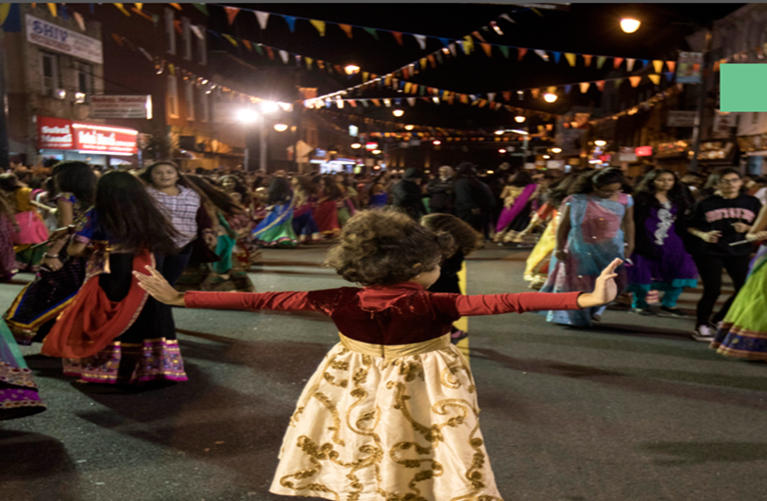
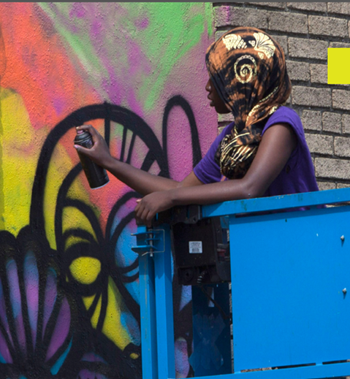
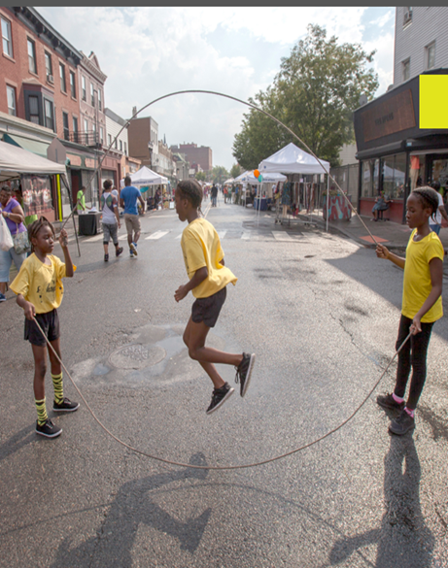

Slide 30
Thank you
Contact me
cgandulla@jcnj.org
or
201-547-5304

